Slide 1
Non- Parametric Test
Mann-Whitney U test

Slide 2
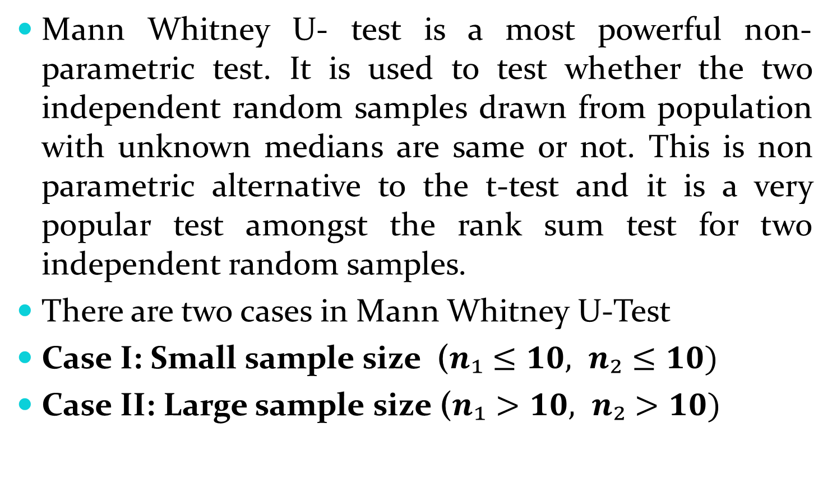
Mann Whitney U- Test:
Mann Whitney U- test is a most powerful non-parametric test. It is used to test whether the two independent random samples drawn from population with unknown medians are same or not. This is non parametric alternative to the t-test and it is a very popular test amongst the rank sum test for two independent random samples.
There are two cases in Mann Whitney U-Test
Case I: Small sample size ($n₁≤10, n₂≤10)$
Case II: Large sample size ($n₁>10, n₂>10)$

Slide 3
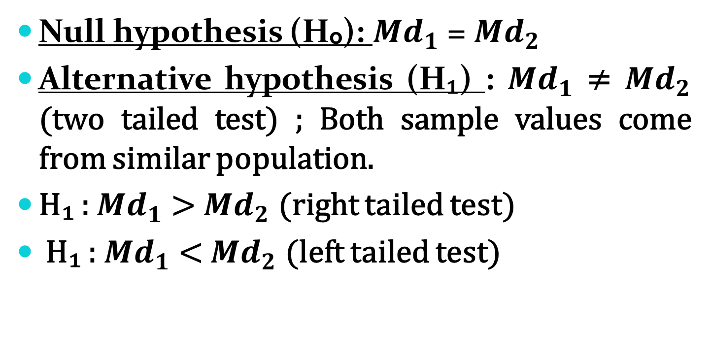
Case I: Small Sample case:
Null hypothesis (Hₒ): ${Md}_{1}$ = ${Md}_{2}$
Alternative hypothesis (H₁) : ${Md}_{1}$ ≠ ${Md}_{2}$ (two tailed test) ; Both sample values come from similar population.
H₁ : ${Md}_{1}$ > ${Md}_{2}$ (right tailed test)
H₁ : ${Md}_{1}$ < ${Md}_{2}$ (left tailed test)

Slide 4
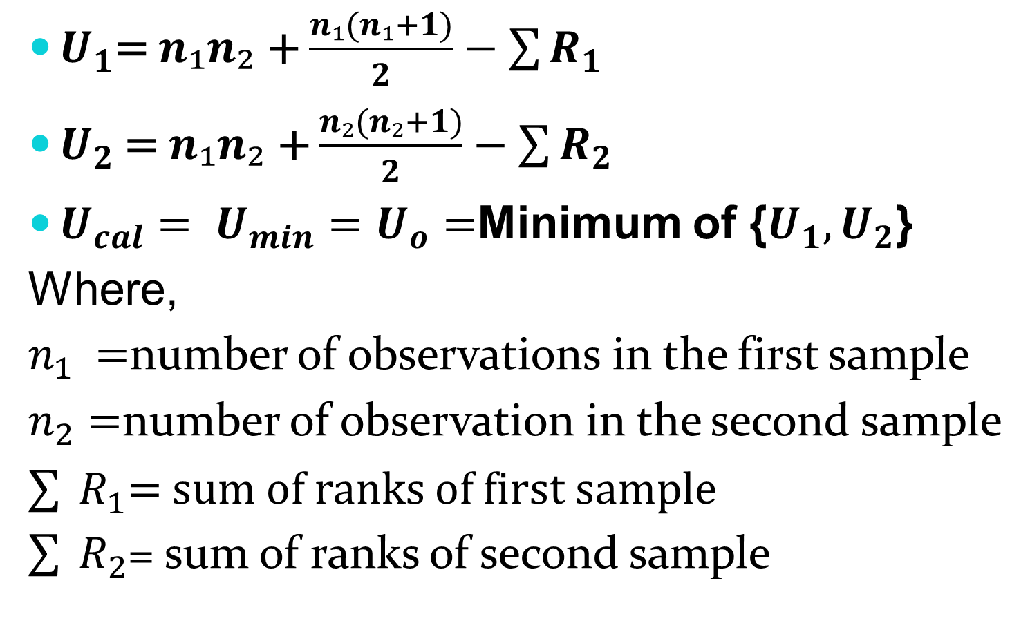
Test Statistic: Under H0
$U_{1}$= $n₁n₂$ + $\frac{n₁(n₁+1)}{2}−$ $\sum{R_{1}}$
$U_{2}$ = $n₁n₂$ + $\frac{n₂(n₂+1)}{2}−$ $\sum{R_{2}}$
$U_{cal}= U_{min}=$ $U_{o}=$Minimum of {$U_{1}{,U}_{2}$}
Where,
$n_{1 }=$number of observations in the first sample
$n_{2}$ $=$number of observation in the second sample
$\sum{ }R_{1}$= sum of ranks of first sample
$\sum{ }R_{2}$= sum of ranks of second sample

Slide 5
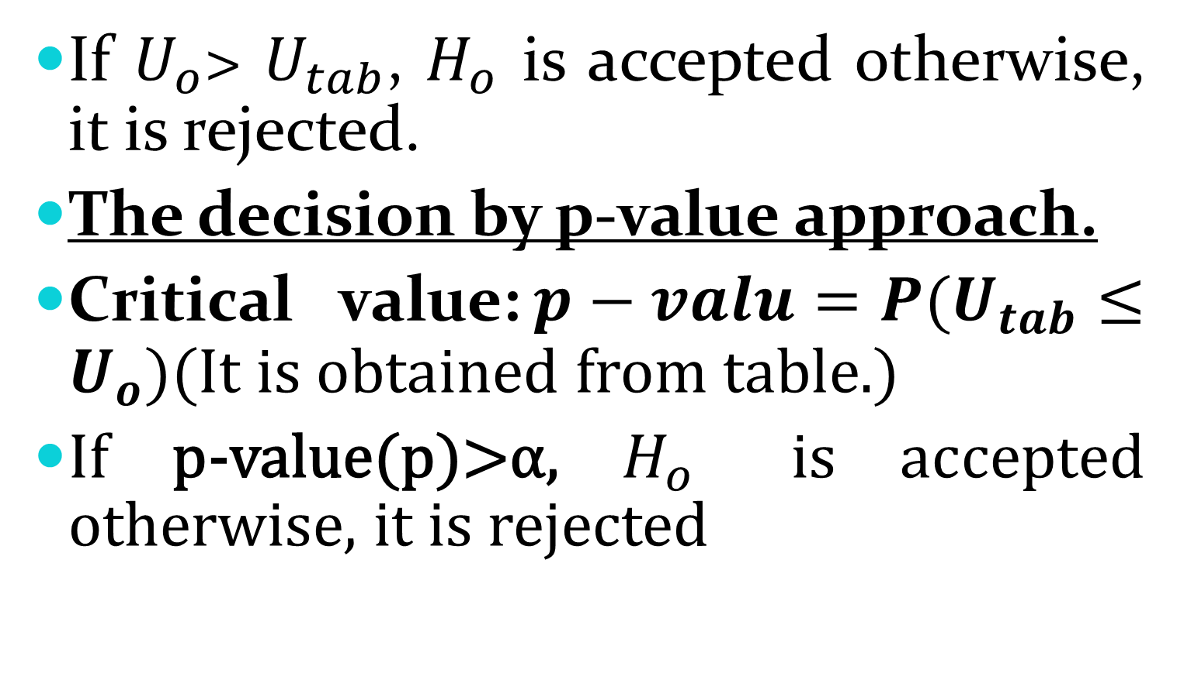
Decision:
If $U_{o}$> $U_{tab}$, $H_{o}$ is accepted otherwise, it is rejected.
The decision by p-value approach.
Critical value:$p−valu=P(U_{tab}≤U_{o}$)(It is obtained from table.)
If p-value(p)>α, $H_{o}$ is accepted otherwise, it is rejected

Slide 6
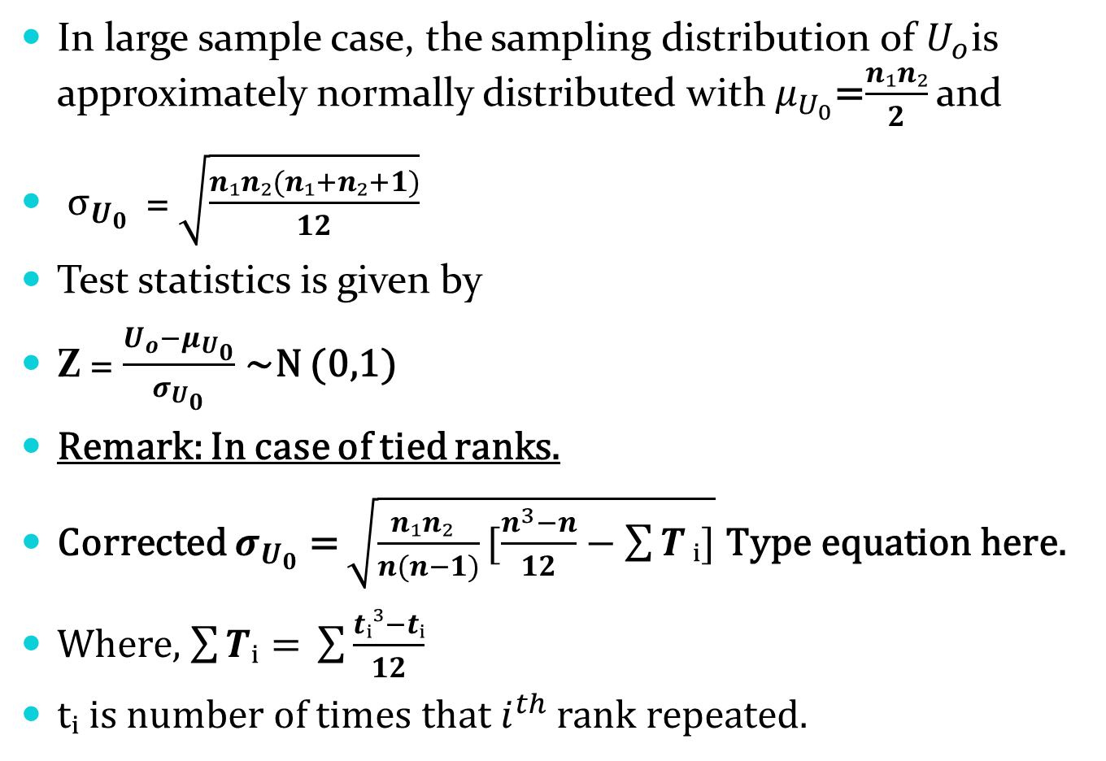
Case II: Large sample case:
In large sample case, the sampling distribution of $U_{o}$is approximately normally distributed with $μ_{U_{0}}$=$\frac{n₁n₂}{2}$ and
$σ_{U_{0}}$ = $\sqrt{\frac{n₁n₂(n₁+n₂+1)}{12}}$
Test statistics is given by
Z = $\frac{U_{o}−μ_{U_{0}}}{σ_{U_{0}}}$ ~N (0,1)
Remark: In case of tied ranks.
Corrected $σ_{U_{0}}$ = $\sqrt{\frac{n₁n₂ }{n(n−1)}[\frac{n^{3}−n}{12}−\sum{T}ᵢ]}$
Where, $\sum{Tᵢ= }\sum{\frac{tᵢ³−tᵢ}{12}}$
tᵢ is number of times that $i^{th}$ rank repeated.

Slide 7
Problems:
Measurements of the acidity(pH) of rain sample were recorded at 4 sites of industrial region and 55 sites of non-industrial region:
Is the difference of acidity of rain between the industrial region and non-industrial region significant?
Industrial region | 6.3 | 4.9 | 3.0 | 6.0
Non-industrial region | 4.2 | 4.5 | 3.1 | 4.4 | 5.0

Slide 8
Problems:
The heart beating rate of 5 vegetarians and non-vegetarians are recorded below
Is the mean heart beating rate of non-vegetarians significantly high. Use Mann Whitney U test.
Vegetarians | 56 | 67 | 82 | 60 | 75
Non-Vegetarians | 53 | 42 | 75 | 58 | 65

Slide 9
Problems:
Test the hypothesis of no difference between the ages of male and female employees of a certain IT company, using Mann-Whitney U test for the sample data below. Use α = 0.1.
Male | 35 | 43 | 26 | 44 | 40 | 42 | 33 | 38 | 25 | 26
Female | 30 | 41 | 34 | 31 | 36 | 32 | 25 | 47 | 28 | 24

Slide 10
Problems:
The following are the scores which random samples of students from 2 groups obtained on a random coding test.
Use Mann Whitney U test at the 0.05 level of significance to test whether or not students from the two groups can be expected to score equally well on the test.
Group I | 73 | 82 | 39 | 68 | 91 | 75 | 89 | 67 | 50 | 86 | 57 | 65 | 70
Group II | 51 | 42 | 36 | 53 | 88 | 59 | 49 | 66 | 25 | 64 | 18 | 76 | 74

Slide 11
Problems:
Comparing 2 kind of emergency flares, a consumer testing service obtained the following burning times( rounded to the nearest tenth of a minute):
Use Mann Whitney U test at the 0.01 level of significance to check whether it is reasonable to say that the population of burning times of the two kinds of flares are identical.
Brand A | 19.4 | 21.5 | 15.3 | 17.4 | 16.8 | 16.6 | 20.3 | 22.5 | 21.3 | 23.4 | 19.7 | 21.0
Brand B | 16.5 | 15.8 | 24.7 | 10.2 | 13.5 | 15.9 | 15.7 | 14.0 | 12.1 | 17.4 | 15.6 | 15.8

Slide 12
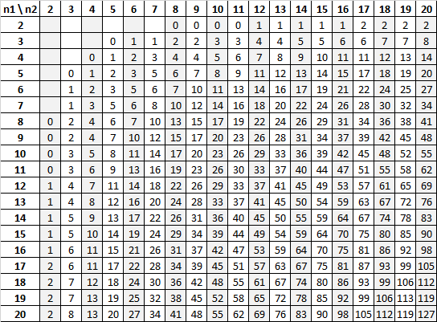
Critical value of U for two tailed test at 0.05

Slide 13
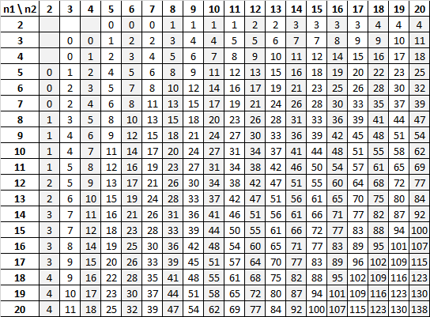
Critical Values of U for a two tailed test at 0.10

